Slide 1

Battle of the Neighborhoods: Tokyo, Japan
Coffee Shops and Restaurants
By: Jason Robson

Slide 2

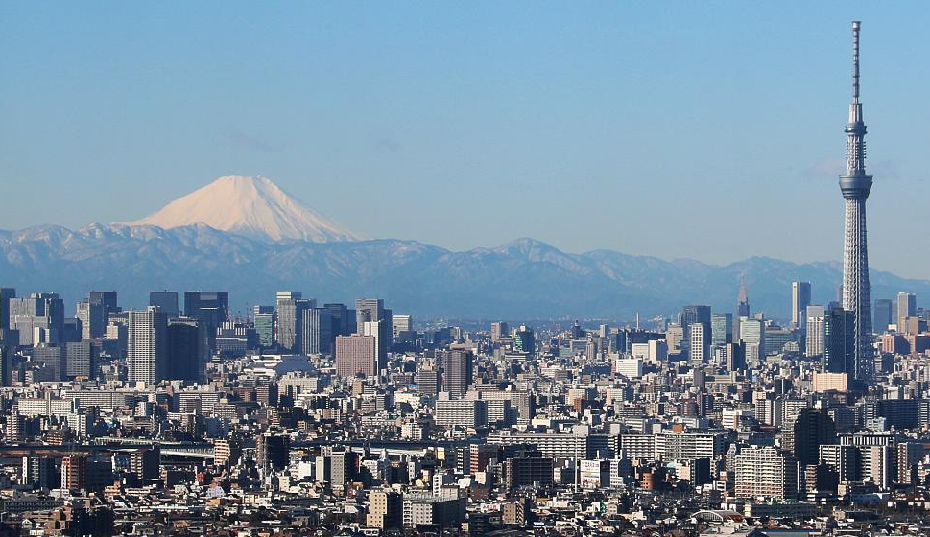
Business Problem
Kentaro is a financial adviser for Fujitsu
Kentaro recently had success in the stock market and wants to leave the telecommunication business
Kentaro wants to open new restaurant or coffee shop in the Tokyo area.
Tokyo, Japan has 23 special wards.
Kentaro wants to know what ward to open his business and what type of business he should open

Slide 3
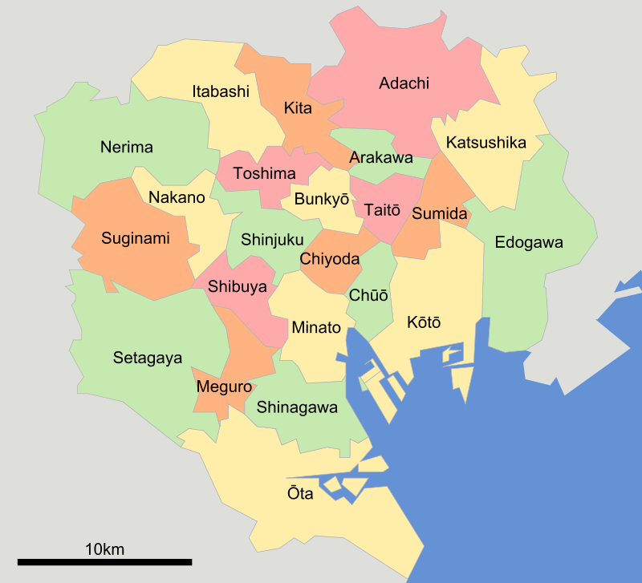
Data Description
The type of data selected for Kentaro consists of Tokyo, Japan special wards. https://en.wikipedia.org/wiki/Special_wards_of_Tokyo#List_of_special_wards
Data will be collected on special ward name, population, density, area, and major districts.
The information will be used to collect information on the various coffee shops and restaurants in a specific ward using Foursquare.

Slide 4
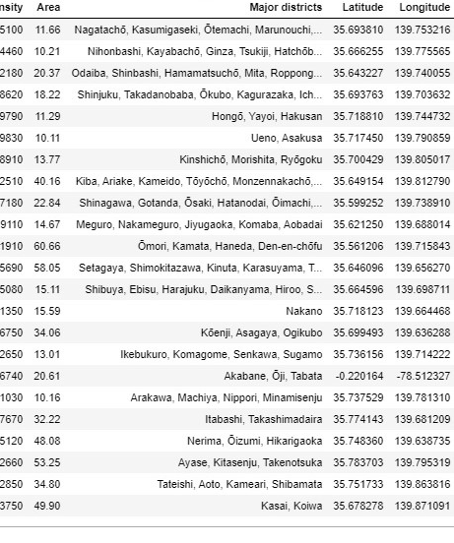
Methodology
The data underwent cleaning using Python and Panadas.
Foursquare was used to collect all the venues near Tokyo.
Foursquare determined there are 31 coffee shops and 45 unique categories of restaurants in the Tokyo area.
K-means was used to cluster restaurant venue data into clusters based on the similarities (mean) of venue categories.
The coordinates of Tokyo, Japan were used to generate a map and the five clusters were assigned to the map.

Slide 5
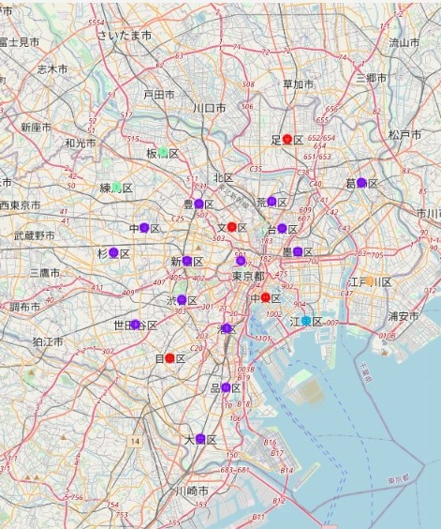
Results
31 coffee shops and 45 unique categories of restaurants in the Tokyo area.
Chiyoda, Taitō, Chūō are the top three special wards with the most coffee shops.
Ramen, Japanese, and Chinese make up the top three restaurants by venue.
The top three special wards with the most unique restaurants are Chūō with 57, Ōta with 41, and Chiyoda with 31 unique restaurants.
All five clusters were mapped to Tokyo, Japan using folium.

Slide 6
Discussion
The business problem: Kentaro wants to open either a coffee shop or a restaurant in Tokyo, Japan.
The collected data should be able to answer his questions.
Chiyoda, Chūō, and Ōta special wards are hotspots for food and drink.
People migrate from where they live to those three main special wards for food and drink.
I’d advise Kentaro to investigate opening a coffee shop in Ōta. There is opportunity in that area to grow and develop as a business.

Slide 7
Conclusion
Kentaro wanted help in deciding what type of business to open and where.
My conclusion is for Kentaro to open a coffee shop in Ōta.
The special ward has a dense population and a lively restaurant industry.
There is potential in opening a coffee shop and differentiating it from other businesses.

